Slide 1

MapReduce programming – part I
1

Slide 2
Agenda
Introduction to Hadoop
Introduction to Map Reduce
Hadoop nodes & daemons
Hadoop Architecture
Introduction to HDFS
Characteristics
Hadoop Features
2

Slide 3
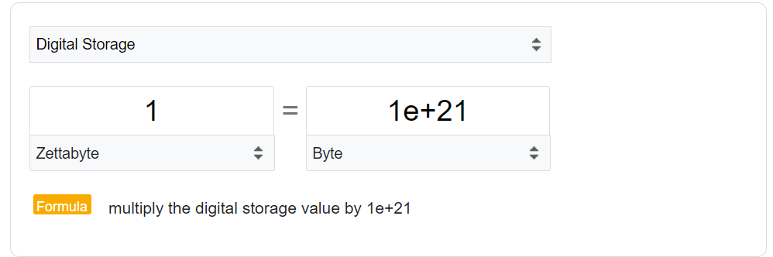
The grand Data Challenge
IDC predicts that the Global Data will grow from 33 Zettabytes (ZB) in 2018 to 175 ZB by 2025.
We need a solution to handle huge volumes of data efficiently
Can this software leverage the distributed computing ?
The software has to be highly fault tolerant, reliable & available
3

Slide 4
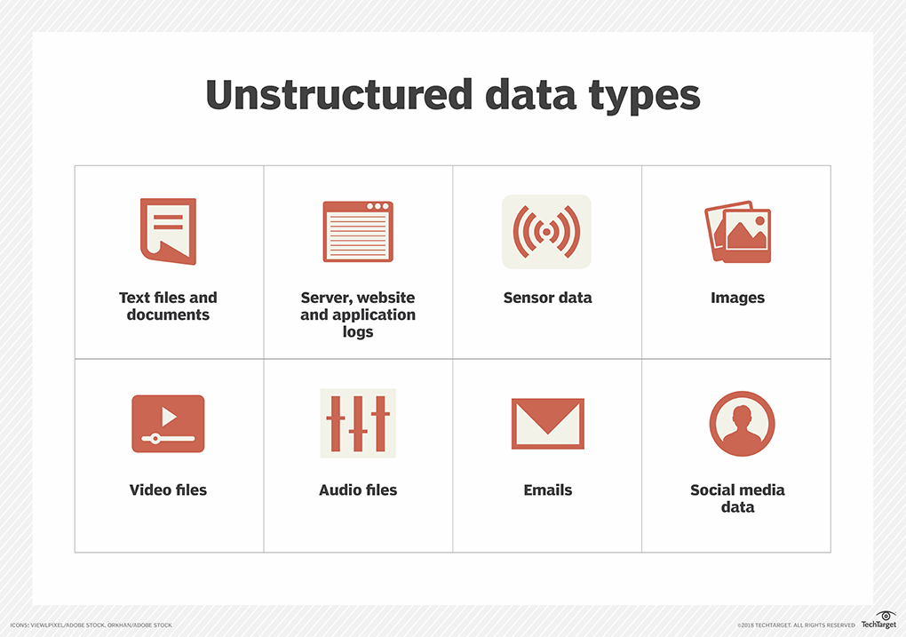
4

Slide 5
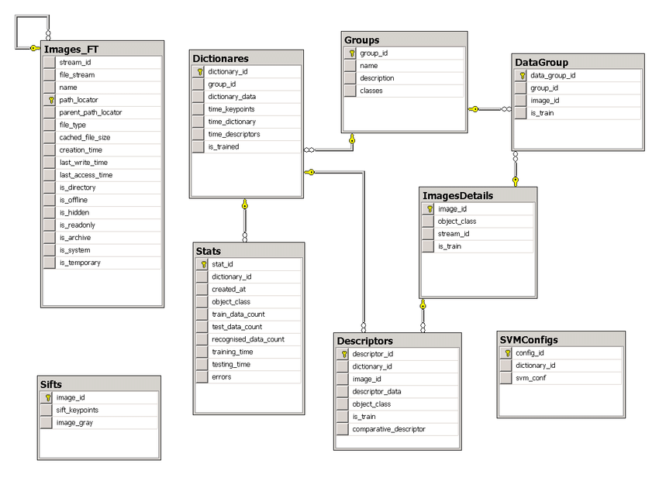
Structured Data
5

Slide 6

What is Hadoop? inventor is Doug Cutting
An Open Source framework that allows distributed processing of large data-sets across the cluster of commodity hardware
6

Slide 7





Hadoop History
Doug Cutting added
DFS & MapReduce
in
Hadoop defeated
Super computer
converted 4TB of
image archives over
100 EC2 instances
Doug Cutting started
working on
Doug Cutting
joined Cloudera
2002
2003
2004
2005
2006
2007
2008
2009
published GFS &
MapReduce papers
Hadoop became
top-level project
Development of
started as Lucene sub-project
launched Hive,
SQL Support for Hadoop
7

Slide 8
Hadoop Usecase examples
Smart Grid Analytics:
Predictive Maintenance:
Media and Entertainment:
Content Recommendation:
Ad Targeting:
Security and Intelligence: G
Healthcare Management:
Transportation and Logistics:
Route Optimization:
Agriculture:
Precision Agriculture:
Retail and E-commerce:
Customer Analytics:
Fraud Detection:
Genomics and Drug Discovery:
Healthcare Analytics:
Telecommunications:
Network Optimization: .
Manufacturing:
Quality Control:
Supply Chain Optimization:
Energy and Utilities:
8

Slide 9
What is Hadoop?
An open source framework that allows Distributed Processing of large data-sets across the cluster of commodity hardware
Distributed Processing
Data is processed distributedly on multiple nodes / servers
Multiple machines processes the data independently
9

Slide 10




Hadoop Components
Hadoop consists of Four key parts
10

Slide 11
Background to Map Reduce
Traditional programming is serial
Parallel programming
Break processing into parts that can be executed concurrently on multiple processors
Challenge
Identify tasks that can run concurrently
and/or groups of data that can be processed concurrently
Not all problems can be parallelized
11

Slide 12




Simplest environment for parallel processing
No dependency among data
Data can be split into lots of smaller chunks – shards
Shards are pieces of decomposed data
Each process can work on a chunk
Master/worker approach
Master
Worker
Initializes array and splits it according to # of workers
Sends each worker the sub-array
Receives the results from each worker
Receives a sub-array from master
Performs processing
Sends results to master
12

Slide 13
Background to Map Reduce
13

Slide 14
MapReduce
Created by Google in 2004
Jeffrey Dean and Sanjay Ghemawat
Inspired by LISP
Map(function, set of values)
Applies function to each value in the set
(map ‘length ‘(() (a) (a b) (a b c))) ⇒ (0 1 2 3)
Reduce(function, set of values)
Combines all the values using a binary function (e.g., +) (reduce #'+ ‘(1 2 3 4 5)) ⇒ 15
14

Slide 15
MapReduce
MapReduce
Framework for parallel computing
Programmers get simple API
Don’t have to worry about handling
parallelization
data distribution
load balancing
fault tolerance
Allows one to process huge amounts of data (terabytes and petabytes) on thousands of processors
15

Slide 16
Who has it?
Google
Original proprietary implementation
Apache Hadoop MapReduce
Most common (open-source) implementation
Built to specs defined by Google
Amazon Elastic MapReduce
Uses Hadoop MapReduce running on Amazon EC2
… or Microsoft Azure HDInsight
… or Google Cloud MapReduce for App Engine
16

Slide 17
MapReduce
Map
Grab the relevant data from the source
User function gets called for each chunk of input Spits out (key, value) pairs
Reduce
Aggregate the results
User function gets called for each unique key with all values corresponding to that key
17

Slide 18
MapReduce
Map: (input shard) → intermediate(key/value pairs)
Automatically partition input data into M shards
Discard unnecessary data and generate (key, value) sets
Framework groups together all intermediate values with the same intermediate key & pass them to the Reduce function
Reduce: intermediate(key/value pairs) → result files
Input: key & set of values
Merge these values together to form a smaller set of values
Reduce workers are distributed by partitioning the intermediate key space into R pieces using a partitioning function (e.g., hash(key) mod R)
The user specifies the # of partitions (R) and the partitioning function
18

Slide 19


MapReduce: what happens in between?
Map
Grab the relevant data from the source (parse into key, value)
Write it to an intermediate file
Partition
Partitioning: identify which of R reducers will handle which keys
Map partitions data to target it to one of R Reduce workers based on a partitioning function (both R and partitioning function user defined)
Shuffle & Sort
Shuffle: Fetch the relevant partition of the output from all mappers
Sort by keys (different mappers may have sent data with the same key)
Reduce
Input is the sorted output of mappers
Call the user Reduce function per key with the list of values for that key to aggregate the results
Map Worker
Reduce Worker

Slide 20

Hadoop Nodes
Nodes
Master Node
Slave Node
20

Slide 21
Hadoop Daemons
Nodes
Master Node
Slave Node
Resource Manager
Node
Manager
NameNode
DataNode
21

Slide 22


Basic Hadoop Architecture
Sub Work
Sub Work
Sub Work
Sub Work
Sub Work
Sub Work
Sub Work
Sub Work
Sub Work
Sub Work
Sub Work
Sub Work
Sub Work
Sub Work
Sub Work
Sub Work
Work
Sub Work
Sub Work
Sub Work
Sub Work
Sub Work
Sub Work
Sub Work
Sub Work
USER
Master(s)
Sub Work
Sub Work
Sub Work
Sub Work
Sub Work
Sub Work
Sub Work
Sub Work
100 SLAVES
22

Slide 23



Fault Tolerance
Failure of nodes are recovered automatically
Framework takes care of failure of hardware as well tasks
23

Slide 24
Reliability
Data is reliably stored on the cluster of machines despite machine failures
Failure of nodes doesn’t cause data loss
24

Slide 25

High Availability
Data is highly available and accessible despite hardware failure
There will be no downtime for end user application due to data
USER
25

Slide 26
Erasure Coding – another way
Data Chunks: The original data is divided into smaller chunks or blocks, each of which is treated as an individual unit.
Parity Chunks: Parity chunks are created from the data chunks using mathematical operations. These chunks contain redundant information that can be used to recover lost or corrupted data.
Redundancy Level: The redundancy level specifies how many parity chunks are generated for each set of data chunks. Common redundancy levels include 2:1, 4:2, and 6:3, where the first number represents data chunks and the second number represents parity chunks.
Reconstruction: In the event of data loss or disk failure, the erasure-coded data can be reconstructed by using the available data chunks and parity chunks. The reconstruction process involves mathematical operations to recover the missing or corrupted data.
26
USER

Slide 27


Scalability
Vertical Scalability – New hardware can be added to the nodes
Horizontal Scalability – New nodes can be added on the fly
“could scale farther than five machines, to tens, hundreds or even thousands, without requiring much manual operation”
27

Slide 28

Data Locality
Move computation to data instead of data to computation
Data is processed on the nodes where it is stored
Data
Data
Data
Data
Storage Servers
App Servers
Algo
Algo
Data
Data
Algorithm
Algo
Algo
Data
Data
28
Servers

Slide 29
Introduction to HDFS
29
Notes:
Introduce myself: 8 years data engineering, data analytics (make sense)

Slide 30
What’s HDFS
HDFS is a distributed file system that is fault tolerant, scalable and extremely easy to expand.
HDFS is the primary distributed storage for Hadoop applications.
HDFS provides interfaces for applications to move themselves closer to data.
30

Slide 31
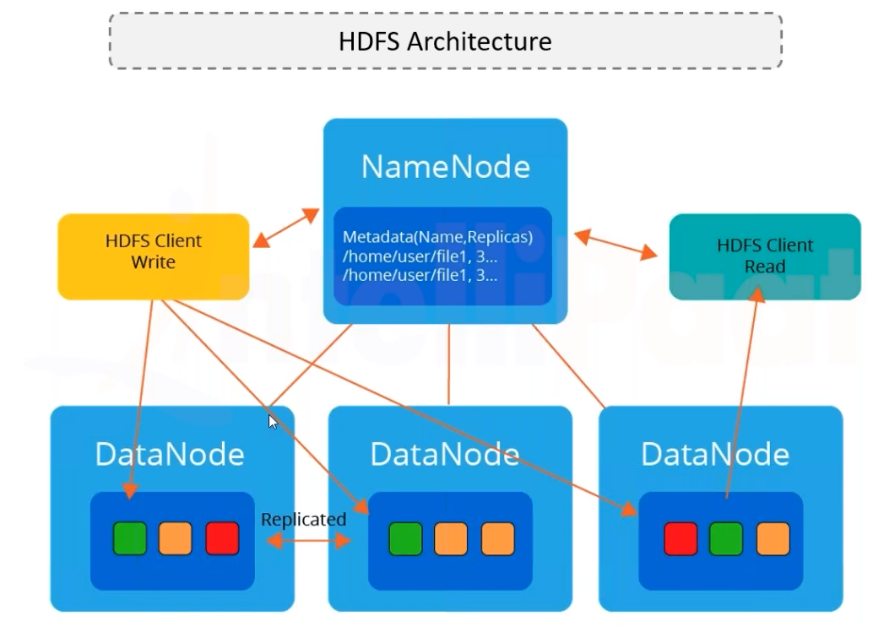
31

Slide 32
Components of HDFS
There are two (and a half) types of machines in a HDFS cluster
NameNode :– is the heart of an HDFS filesystem, it maintains and manages the file system metadata. E.g; what blocks make up a file, and on which datanodes those blocks are stored.
DataNode :- where HDFS stores the actual data, there are usually quite a few of these.
32

Slide 33
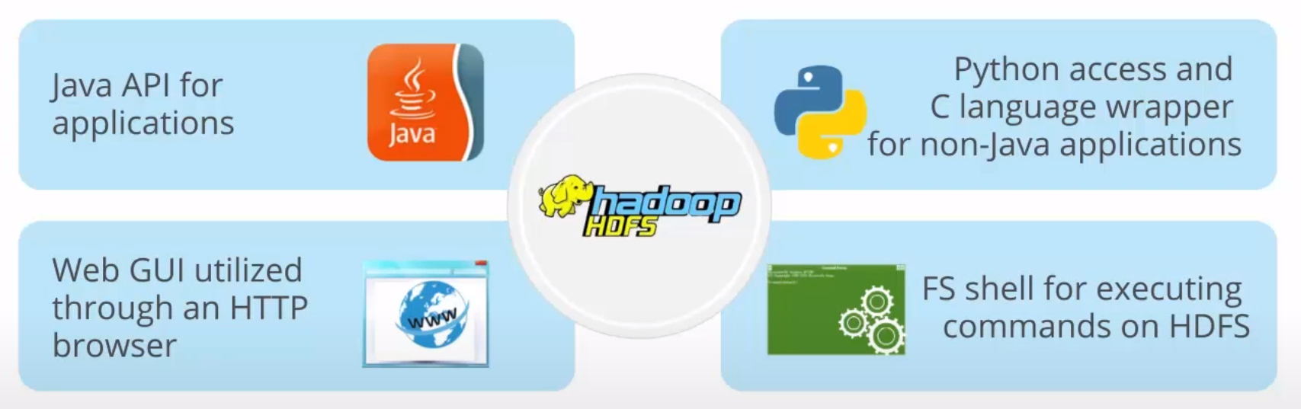
HDFS programming
33

Slide 34
Login to Hadoop system and demo the Example
Count # occurrences of each word in a collection of documents
Map:
Parse data; output each word and a count (1)
Reduce:
Sort: sort by keys (words)
Reduce: Sum together counts each key (word)
map(String key, String value):
// key: document name, value:
for each word w in value:
EmitIntermediate(w, "1");
document contents
reduce(String key, Iterator values):
// key: a word; values: a list of counts
int result = 0;
for each v in values: result += ParseInt(v);
Emit(AsString(result));
34

Slide 35




Example
It will be seen that this mere painstaking burrower and grub-worm of a poor devil of a Sub-Sub appears to have gone through the long Vaticans and street- stalls of the earth, picking up whatever random allusions to whales he could anyways find in any book whatsoever, sacred or profane. Therefore you must not, in every case at least, take the higgledy-piggledy whale statements, however authentic, in these extracts, for veritable gospel cetology. Far from it.
it 1
will 1
be 1
seen 1
that 1
this 1
mere 1
painstaking 1
burrower 1
and 1
grub-worm 1
of 1
… a 1
a 1
aback 1
aback 1
abaft 1
abaft 1
abandon 1
abandon 1
abandon 1
abandoned 1
abandoned 1
a 4736
aback 2
abaft 2
abandon 3
abandoned 7
abandonedly 1
abandonment 2
abased 2
abasement 1
abashed 2
abate 1
abated 3
abatement 1
abating 2
abbreviate 1
abbreviation 1
abeam 1
abed 2
abednego 1
abel 1
abhorred 3
abhorrence 1
As touching the ancient authors generally, as well as the poets here appearing, these extracts are solely valuable or entertaining, as affording a glancing bird's eye view of what has been promiscuously said, thought,
MAP^{a 1}
ab_{R}an_{E}do_{D}ne_{U}d _{C}1 _{E}
poor 1
devil 1
of 1
a 1
sub-sub 1
appears 1
to 1
have 1
gone 1
abandoned 1
abandoned 1
abandoned 1
abandoned 1
abandonedly 1
abandonment 1
abandonment 1
abased 1
abased 1
fancied, and sung of Leviathan, by many nations and generations, including our own.
35

Slide 36
Hadoop details
Hadoop cluster
HDFS can read/write data with performance of 1TB/second
Written block by block
HDFS Block size = 128 MB
HDFS on top of local file system
Use Hadoop commands for your request to go to HDFS
36

Slide 37
Summary
IDC predicts that the Global Data will grow from 33 Zettabytes (ZB) in 2018 to 175 ZB by 2025.
Hadoop handles huge volumes of data efficiently
Hadoop uses the power of distributed computing
HDFS, Yarn, MapReduce, Hive are main components of Hadoop
It is highly fault tolerant, reliable & available
37

Slide 38
MapReduce programming – part II
38

Slide 39
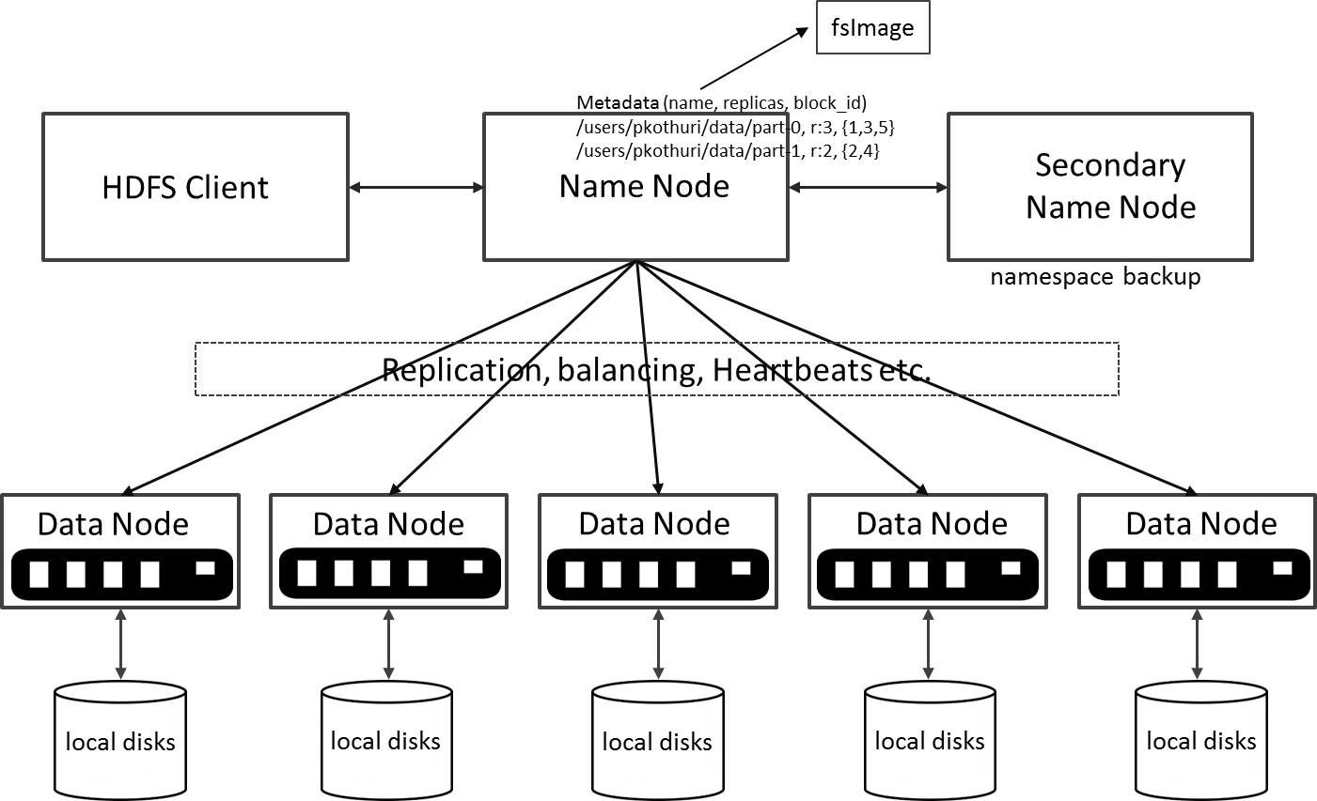
HDFS Architecture
39

Slide 40
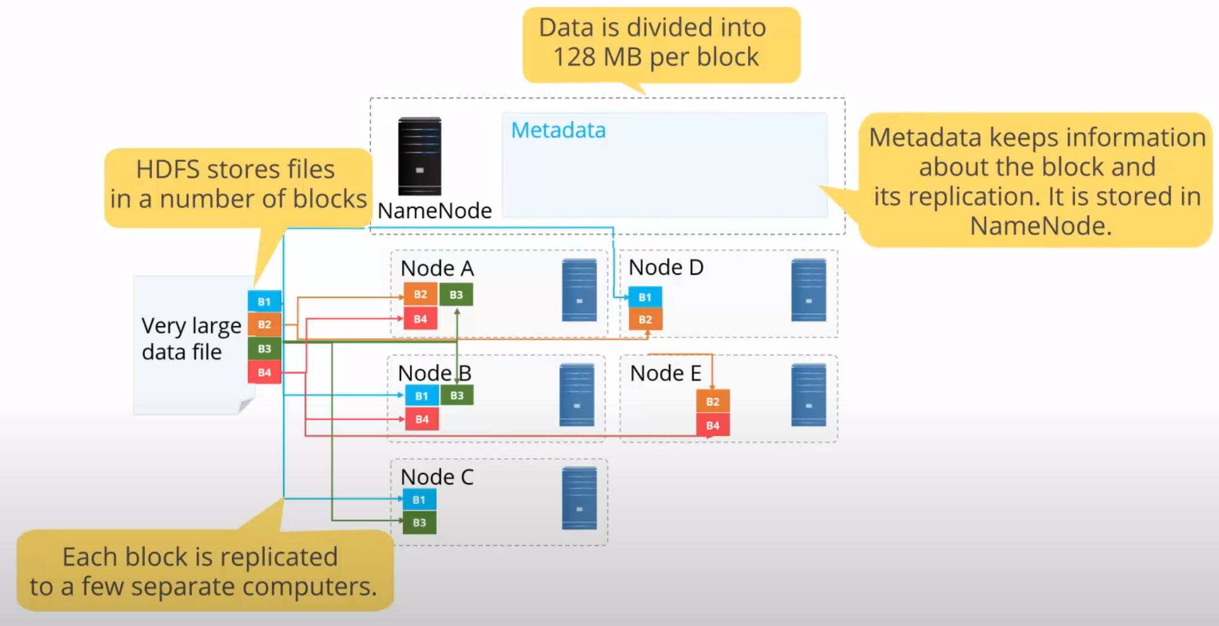
HDFS concepts
40
https://www.youtube.com/watch?v=nRX4_3qf3rc

Slide 41
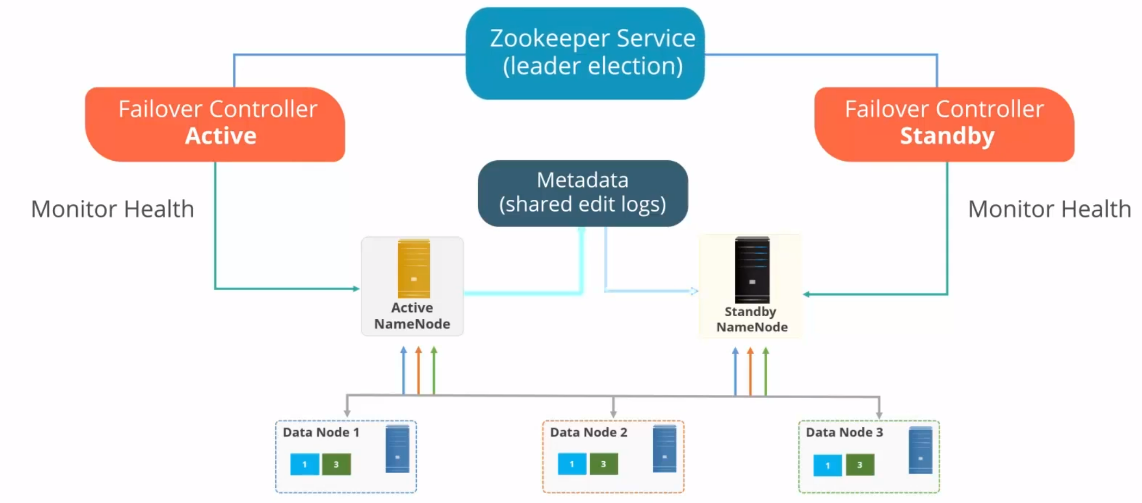
HDFS High Availability
41

Slide 42
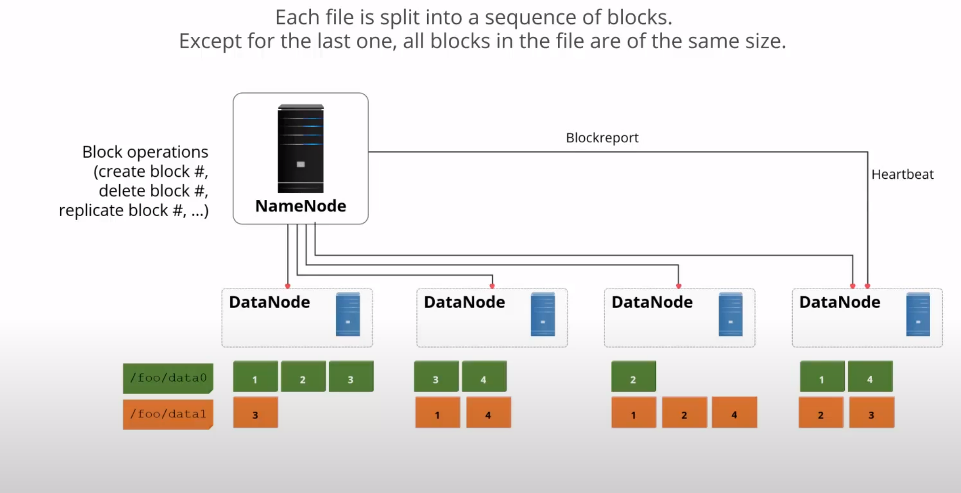
Decomposing the data
42

Slide 43
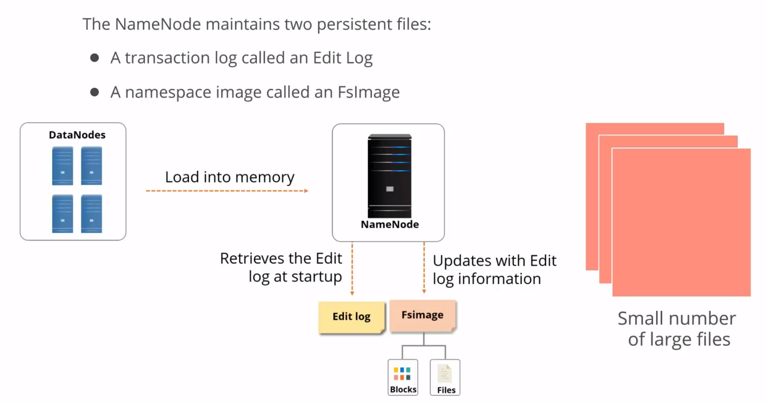
Name Node
43

Slide 44
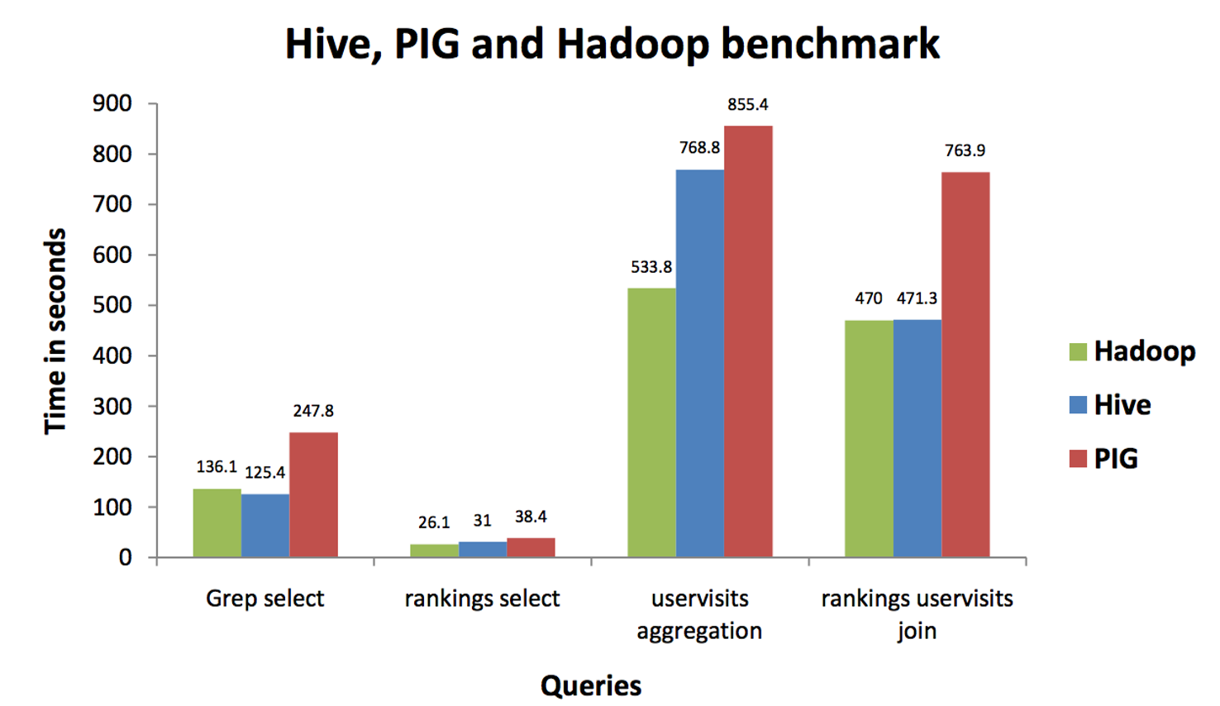
Hive Performance
44

Slide 45

What is Spark?
Apache Spark is a High performance cluster computing technology, designed for fast computation. It is based on Hadoop MapReduce and it extends the MapReduce model to efficiently use it for more types of computations, which includes interactive queries and stream processing. The main feature of Spark is its in-memory cluster computing that increases the processing speed of an application.
45
Notes:
Spark is designed to cover a wide range of workloads such as batch applications, iterative algorithms, interactive queries and streaming.

Slide 46
What is Spark?
Spark module | Usecase | Language
Spark Streaming | real-time analytics | Python
Spark SQL | interactive queries | Scala
Spark MLlib | machine learning | R, Python
Graph processing | Graph processing | Graph X
46
Notes:
Spark is designed to cover a wide range of workloads such as batch applications, iterative algorithms, interactive queries and streaming.

Slide 47
Spark vs Hadoop
Apache Spark | Apache Hadoop
Easy to program and does not require any abstractions. | Difficult to program and requires abstractions.
Programmers can perform streaming, batch processing, and machine learning, all in the same cluster. | It is used for generating reports that help find answers to historical queries.
It has an in-built interactive mode. | No in-built interactive mode except for tools like Pig and Hive.
Executes jobs 10 to 100 times faster than Hadoop MapReduce. | Hadoop MapReduce does not leverage the memory of the Hadoop cluster to the maximum.
Programmers can modify the data in real time through Spark streaming. | It allows you to process just a batch of stored data.
47
Source - ProjectPro
Notes:
Spark is designed to cover a wide range of workloads such as batch applications, iterative algorithms, interactive queries and streaming.

Slide 48
What is Yarn?
Yarn: Hadoop Yarn deployment means, simply, spark runs on Yarn without any pre-installation or root access required. It helps to integrate Spark into Hadoop ecosystem or Hadoop stack.
48

Slide 49
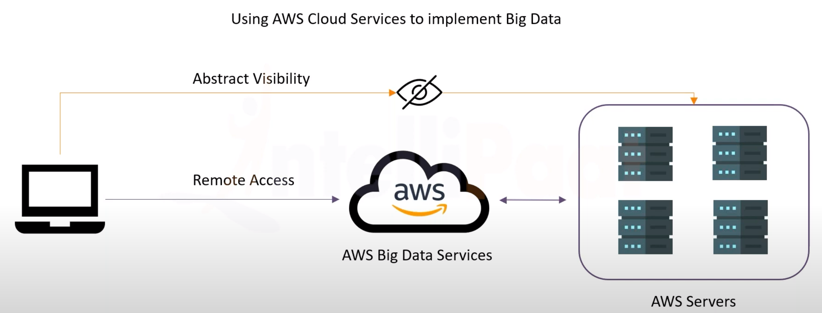
EMR
49

Slide 50
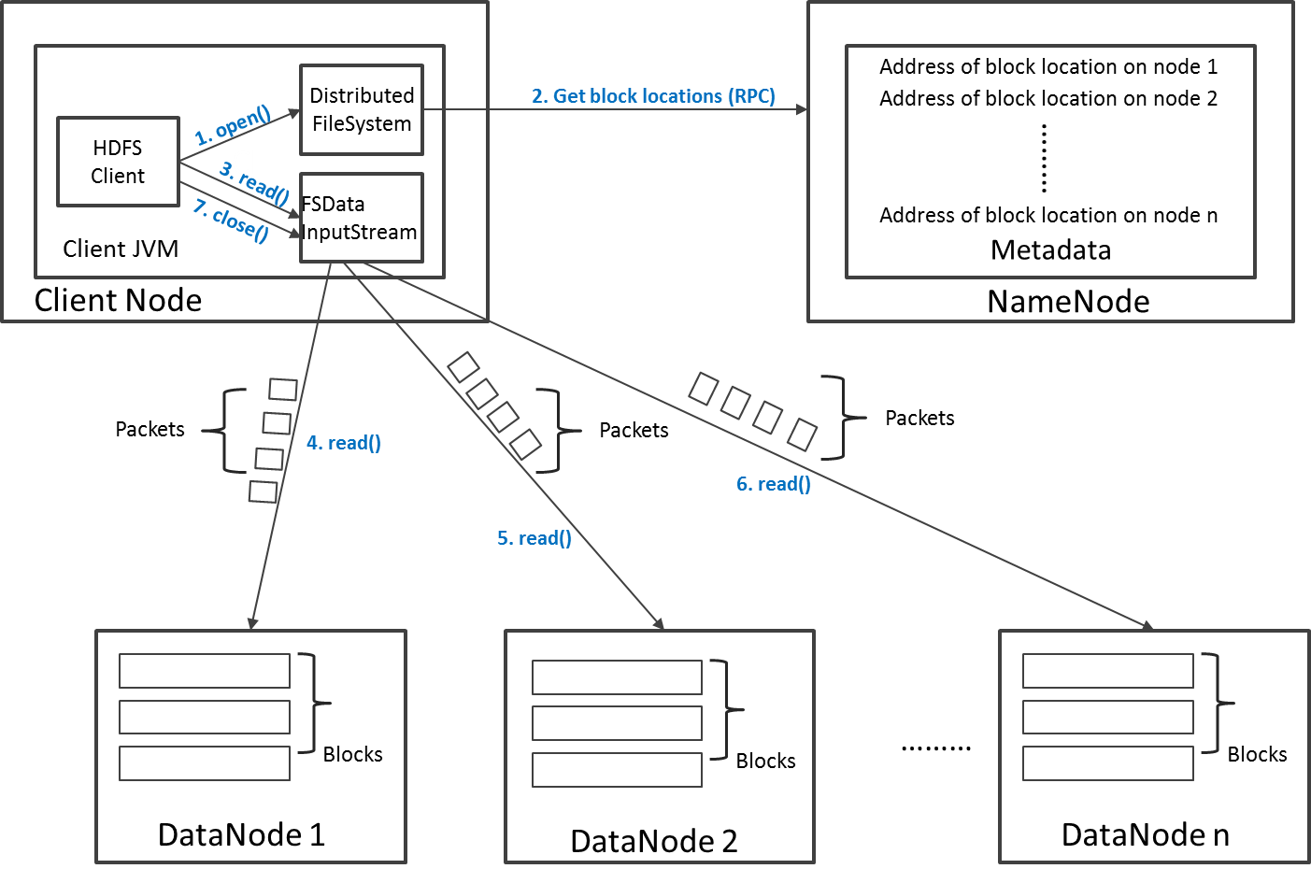
Read Operation in HDFS

Slide 51
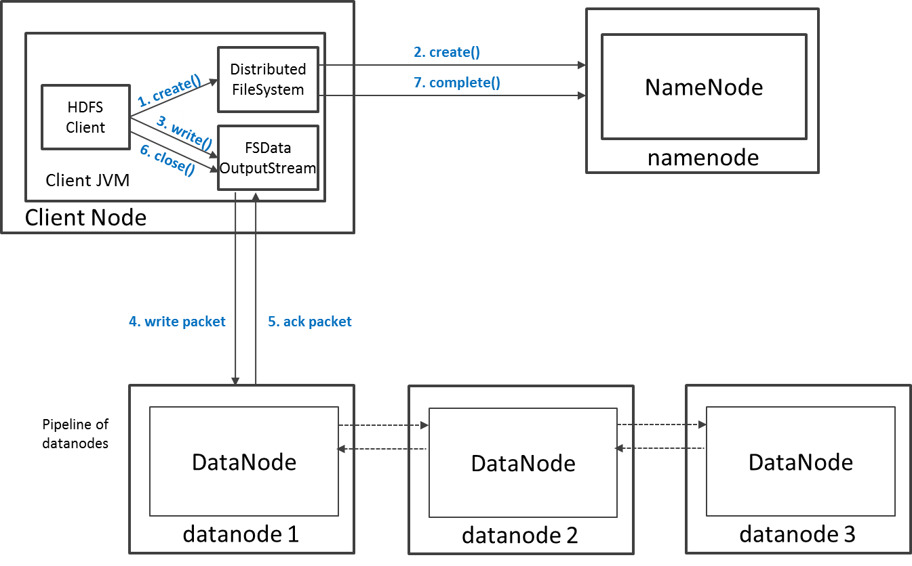
Write Operation in HDFS

Slide 52
HDFS Security
Authentication to Hadoop
Simple – insecure way of using OS username to determine hadoop identity
Kerberos – authentication using kerberos ticket
Set by hadoop.security.authentication=simple|kerberos
File and Directory permissions are same like in POSIX
read (r), write (w), and execute (x) permissions
also has an owner, group and mode
enabled by default (dfs.permissions.enabled=true)
ACLs are used for implemention permissions that differ from natural hierarchy of users and groups
enabled by dfs.namenode.acls.enabled=true
Notes:
NameNode and DataNode each run an internal web server in order to display basic information about the current status of the cluster

Slide 53
Unique features of HDFS
Failure tolerant - data is duplicated across multiple DataNodes to protect against machine failures. The default is a replication factor of 3 (every block is stored on three machines).
Scalability - data transfers happen directly with the DataNodes so your read/write capacity scales fairly well with the number of DataNodes
Space - need more disk space? Just add more DataNodes and re-balance
Industry standard - Other distributed applications are built on top of HDFS (HBase)

Slide 54
HDFS – Data Organization
Each file written into HDFS is split into data blocks
Each block is stored on one or more nodes
Each copy of the block is called replica
Block placement policy
First replica is placed on the local node
Second replica is placed in a different rack
Third replica is placed in the same rack as the second replica
Notes:
NameNode and DataNode each run an internal web server in order to display basic information about the current status of the cluster

Slide 55
HDFS Configuration
HDFS Defaults
Block Size – 128 MB
Replication Factor – 3
Web UI Port – 50070
HDFS conf file - /etc/hadoop/conf/hdfs-site.xml
<property>
<name>dfs.namenode.name.dir</name>
<value>file:///data1/cloudera/dfs/nn,file:///data2/cloudera/dfs/nn</value>
</property>
<property>
<name>dfs.blocksize</name>
<value>268435456</value>
</property>
<property>
<name>dfs.replication</name>
<value>3</value>
</property>
<property>
<name>dfs.namenode.http-address</name>
<value>itracXXX.cern.ch:50070</value>
</property>
Notes:
NameNode and DataNode each run an internal web server in order to display basic information about the current status of the cluster

Slide 56
Interfaces to HDFS
Java API (DistributedFileSystem)
C wrapper (libhdfs)
HTTP protocol
WebDAV protocol
Shell Commands
However the command line is one of the simplest and most familiar

Slide 57
HDFS – Shell Commands
There are two types of shell commands
User Commands
hdfs dfs – runs filesystem commands on the HDFS
hdfs fsck – runs a HDFS filesystem checking command
Administration Commands
hdfs dfsadmin – runs HDFS administration commands
Notes:
NameNode and DataNode each run an internal web server in order to display basic information about the current status of the cluster

Slide 58
Summary
Spark with in-memory-compute, performs extremely fast
58

Slide 59
Quiz
An online retail company wants to perform analytics on data in large Amazon S3 objects using Amazon EMR. An Apache Spark job repeatedly queries the same data to populate an analytics dashboard. The analytics team wants to minimize the time to load the data and create the dashboard. Which approaches could improve the performance? (Select TWO.)
Copy the source data into Amazon Redshift and rewrite the Apache Spark code to create analytical reports by querying Amazon Redshift.
Copy the source data from Amazon S3 into Hadoop Distributed File System (HDFS) using s3distcp.
C) Load the data into Spark DataFrames.
D) Stream the data into Amazon Kinesis and use the Kinesis Connector Library (KCL) in multiple Spark jobs to perform analytical jobs.
E) Use Amazon S3 Select to retrieve the data necessary for the dashboards from the S3 objects.
59

Slide 60
HDFS – User Commands (dfs)
List directory contents
Display the disk space used by files
hdfs dfs –ls
hdfs dfs -ls /
hdfs dfs -ls -R /var
hdfs dfs -du -h /
hdfs dfs -du /hbase/data/hbase/namespace/
hdfs dfs -du -h /hbase/data/hbase/namespace/
hdfs dfs -du -s /hbase/data/hbase/namespace/
Notes:
NameNode and DataNode each run an internal web server in order to display basic information about the current status of the cluster

Slide 61
HDFS – User Commands (dfs)
Copy data to HDFS
Copy the file back to local filesystem
hdfs dfs -mkdir tdata
hdfs dfs -ls
hdfs dfs -copyFromLocal tutorials/data/geneva.csv tdata
hdfs dfs -ls –R
cd tutorials/data/
hdfs dfs –copyToLocal tdata/geneva.csv geneva.csv.hdfs
md5sum geneva.csv geneva.csv.hdfs

Slide 62
HDFS – User Commands (acls)
List acl for a file
List the file statistics – (%r – replication factor)
Write to hdfs reading from stdin
hdfs dfs -getfacl tdata/geneva.csv
hdfs dfs -stat "%r" tdata/geneva.csv
echo "blah blah blah" | hdfs dfs -put - tdataset/tfile.txt
hdfs dfs -ls –R
hdfs dfs -cat tdataset/tfile.txt

Slide 63
HDFS – User Commands (fsck)
Removing a file
List the blocks of a file and their locations
Print missing blocks and the files they belong to
hdfs dfs -rm tdataset/tfile.txt
hdfs dfs -ls –R
hdfs fsck /user/cloudera/tdata/geneva.csv -files -blocks –locations
hdfs fsck / -list-corruptfileblocks

Slide 64
HDFS – Adminstration Commands
Comprehensive status report of HDFS cluster
Prints a tree of racks and their nodes
Get the information for a given datanode (like ping)
hdfs dfsadmin –report
hdfs dfsadmin –printTopology
hdfs dfsadmin -getDatanodeInfo localhost:50020
Notes:
NameNode and DataNode each run an internal web server in order to display basic information about the current status of the cluster

Slide 65
HDFS – Advanced Commands
Get a list of namenodes in the Hadoop cluster
Dump the NameNode fsimage to XML file
The general command line syntax is
hdfs command [genericOptions] [commandOptions]
hdfs getconf –namenodes
cd /var/lib/hadoop-hdfs/cache/hdfs/dfs/name/current
hdfs oiv -i fsimage_0000000000000003388 -o /tmp/fsimage.xml -p XML
Notes:
NameNode and DataNode each run an internal web server in order to display basic information about the current status of the cluster

Slide 66
Other Interfaces to HDFS
HTTP Interface
MountableHDFS – FUSE
Once mounted all operations on HDFS can be performed using standard Unix utilities such as 'ls', 'cd', 'cp', 'mkdir', 'find', 'grep',
http://quickstart.cloudera:50070
mkdir /home/cloudera/hdfs
sudo hadoop-fuse-dfs dfs://quickstart.cloudera:8020 /home/cloudera/hdfs

Slide 67
Source of info
Much of this information is from Google:
Google Code University [no longer supported]
http://code.google.com/edu/parallel/mapreduce-tutorial.html
MapReduce: The programming model and practice research.google.com/pubs/pub36249.html
See also: http://hadoop.apache.org/common/docs/current/ for the Apache Hadoop version
Read this (the definitive paper):
http://labs.google.com/papers/mapreduce.html

Slide 68





















































MapReduce: the complete picture
client
master
forks
Shard 0
Assign tasks
Shard 1
Map worker
IF
Output file 1
Reduce worker
Shard 2
Shard 3
Map worker
IF
…
Reduce worker
Output file 2
Map worker
IF
Shard M-1
R work items
M work items
Intermediate files

Slide 69





Step 1: Split input files into chunks (shards)
Break up the input data into M pieces (typically 64 MB)
Shard 0 | Shard 1 | Shard 2 | Shard 3 | … | Shard M-1
Input files
Divided into M shards

Slide 70
Step 2: Fork processes
Start up many copies of the program on a cluster of machines
One master: scheduler & coordinator
Lots of workers
Idle workers are assigned either:
map tasks (each works on a shard) – there are M map tasks
reduce tasks (each works on intermediate files) – there are R
R = # partitions, defined by the user
User program
Remote fork
master
worker
worker
worker
…

Slide 71




Step 3: Run Map Tasks
Reads contents of the input shard assigned to it
Parses key/value pairs out of the input data
Passes each pair to a user-defined map function
Produces intermediate key/value pairs
These are buffered in memory
read
Map worker
Shard 2

Slide 72




Step 4: Create intermediate files
Intermediate key/value pairs produced by the user’s map function buffered in memory and are periodically written to the local disk
– Partitioned into R regions by a partitioning function
Intermediate file
read
Map worker
local write
Partition 1
Shard n
Partition 1
Partition R-1

Slide 73
Step 4a. Partitioning
Map data will be processed by Reduce workers
User’s Reduce function will be called once per unique key generated by Map.
We first need to sort all the (key, value) data by keys and decide which Reduce worker processes which keys
The Reduce worker will do the sorting
Partition function
Decides which of R reduce workers will work on which key
Default function: hash(key) mod R
Map worker partitions the data by keys
Each Reduce worker will later read their partition from every Map worker

Slide 74



















Step 5: Reduce Task: sorting
Reduce worker gets notified by the master about the location of intermediate files for its partition
Shuffle: Uses RPCs to read the data from the local disks of the map workers
Sort: When the reduce worker reads intermediate data for its partition
It sorts the data by the intermediate keys
All occurrences of the same key are grouped together
Map worker
local write
Intermediate file
remote read
Reduce worker
Map worker
local write
Intermediate file
remote read
Reduce worker

Slide 75
Step 6: Reduce Task: Reduce
The sort phase grouped data with a unique intermediate key
User’s Reduce function is given the key and the set of intermediate values for that key
< key, (value1, value2, value3, value4, …) >
The output of the Reduce function is appended to an output file
Intermediate file
Intermediate file
remote read
write
Output file
Reduce worker
Intermediate file

Slide 76
Step 7: Return to user
When all map and reduce tasks have completed, the master wakes up the user program
The MapReduce call in the user program returns and the program can resume execution.
– Output of MapReduce is available in R output files

Slide 77
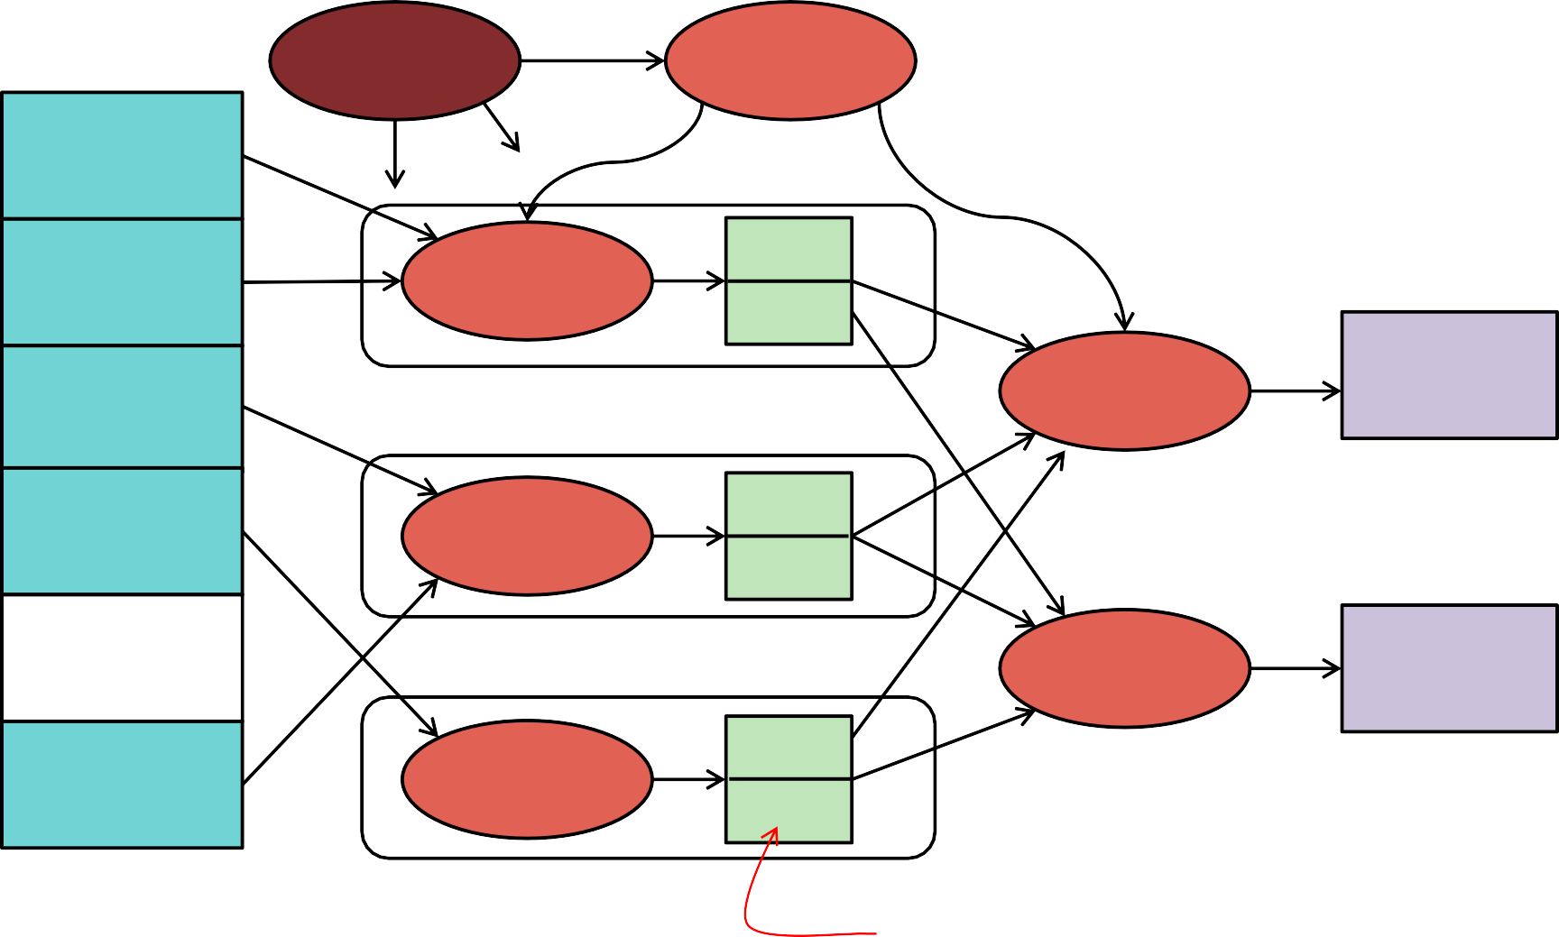
MapReduce: the complete picture
client
master
forks
Shard 0
Assign tasks
Shard 1
Map worker
IF
Reduce worker
Output file 1
Shard 2
Shard 3
Map worker
IF
…
Reduce worker
Output file 2
Map worker
IF
Shard M-1
R work items
M work items
Intermediate files
MAP
SHUFFLE
REDUCE

Slide 78
Fault tolerance
Master pings each worker periodically
If no response is received within a certain time, the worker is marked as failed
Map or reduce tasks given to this worker are reset back to the initial state and rescheduled for other workers.

Slide 79
Locality
Input and Output files
GFS (Google File System)
Bigtable
MapReduce (often) runs on GFS chunkservers
Keep computation close to the files if possible
Master tries to schedule map worker on one of the machines that has a copy of the input chunk it needs.

Slide 80




Other Examples
Distributed grep (search for words)
Search for words in lots of documents
Map: emit a line if it matches a given pattern
Reduce: just copy the intermediate data to the output
Map
Input: line of text If pattern matches
Output: (””, line)
Reduce
Input: “”, [lines] Output: lines
25

Slide 81



Other Examples
List URL access counts
Find the count of each URL in web logs
Map: process logs of web page access; output <URL, 1>
Reduce: add all values for the same URL
Map
Input: line from log Output: (url, 1)
Reduce
Input: url, [accesses] Output: url, sum(accesses)

Slide 82







Other Examples
Count URL access frequency
Find the frequency of each URL in web logs
Run 1: just count total URLs
Run 2: just like URL count but now we stored total_urls
Run 1
Map
Input: line from log Output: ("", 1)
Reduce
Input: "", [1, 1, …, 1]
Output: total_urls=sum(1, 1, … , 1)
Run 2
Map
Input: line from log Output: (url, 1)
Reduce
Input: url, [accesses]
Output: url, sum(accesses)/total_urls

Slide 83




Other Examples
Count URL access frequency
Can we avoid processing the input data twice?
Technically, no, but there's a hack
Map task sends its total URL count to all reducers with key=""
The key "" happens to be the one that gets processed first
Map: process logs of web page access
Output <URL, 1>
Output total URL count to all reducers
Reduce: add all values for the same URL
Map
Input: line from log Output: (url, 1)
Finally: output: ("", total_url_count)
Reduce
Input: url, [accesses]
if (key=="") total_urls=sum(accesses) Output: url, sum(accesses)/total_urls

Slide 84




Other Examples
Reverse web-link graph
Find where page links come from
Map: output <target, source> for each link to target in a page source
Reduce: concatenate the list of all source URLs associated with a target.
Output <target, list(source)>
Map
Input: HTML files Output: (target, source)
Reduce
Input: target, [sources] Output: target, [sources]
The reduce function does nothing!

Slide 85



Other Examples
Inverted index
Find what documents contain a specific word
Map: parse document, emit <word, document-ID> pairs
Reduce: for each word, sort the corresponding document IDs Emit a <word, list(document-ID)> pair
The set of all output pairs is an inverted index
Map
Input: document Output: (word, doc_id)
Reduce
Input: word, [doc_id] Output: word, [doc_id])

Slide 86




Other Examples
Stock summary
Find average daily gain of each company from 1/1/2000 – 12/31/2015
Data is a set of lines: { date, company, start_price, end_price }
Map
If (date >= “1/1/2000” && date <= “12/31/2015”)
Output: (company,
end_price-start_price)
Reduce
Input: company, [daily_gains] Output: word, average([daily_gains])

Slide 87








Other Examples: Two rounds
Average salaries in regions
Show zip codes where average salaries are in the ranges:
(1) < $100K (2) $100K … $500K (3) > $500K
Data is a set of lines: { name, age, address, zip, salary }
Map
Output: (zip, salary)
Reduce
Input: zip, [salary]
Output: zip, average([salary])
Show average salary for each zip code
Map(zip, salary)
if (salary < 100K)
output(“<$100K”, zip) else if (salary > 500K)
output(“>$500K”, zip)
else
output(“$100-500K”, zip)
Reduce
Input: range, [zips]
Output: range For z in zips
output(z)
32

Slide 88
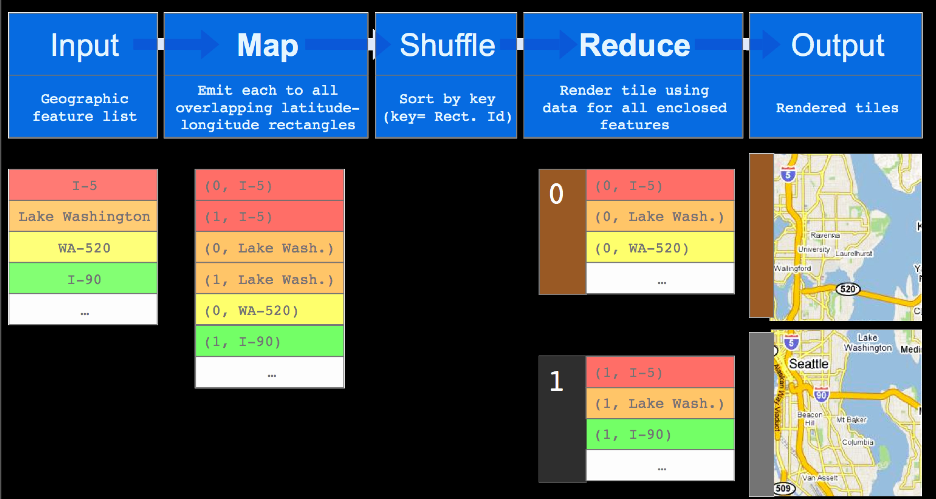






MapReduce for Rendering Map Tiles
From Designs, Lessons and Advice from Building Large Distributed Systems Jeff Dean, Google
http://www.odbms.org/download/dean-keynote-ladis2009.pdf Used with permission

Slide 89
MapReduce Summary
Get a lot of data
Map
Parse & extract items of interest
Sort (shuffle) & partition
Reduce
Aggregate results
Write to output files

Slide 90
All is not perfect
Web has become more dynamic
an 8+ hour delay is a lot for some sites
Goal: refresh certain pages within seconds
MapReduce
Batch-oriented
Not suited for near-real-time processes
Cannot start a new phase until the previous has completed
Reduce cannot start until all Map workers have completed
Suffers from “stragglers” – workers that take too long (or fail)
This was done continuously
MapReduce is still used for many Google services
Search framework updated in 2009-2010: Caffeine
Index updated by making direct changes to data stored in Bigtable
Data resides in Colossus (GFS2) instead of GFS

Slide 91
In Practice
Most data not simple files
B-trees, tables, SQL databases, memory-mapped key-values
Hardly ever use textual data: slow & hard to parse
Most I/O encoded with Protocol Buffers

